Slide 1
Smart shopping list
Team: Filip, Amélie, Adam, Udeshkumar, Stefan
Internet of things
Smartphone Application
Smart refigerator generates data
App analyzes the data and presents it adequately
7 months with 5 members

Slide 2
Business Case
Summary
  Description of the app
Background
  Smart objects
  Generate new data
  Data analysis
  Smartphone app presents data

Slide 3
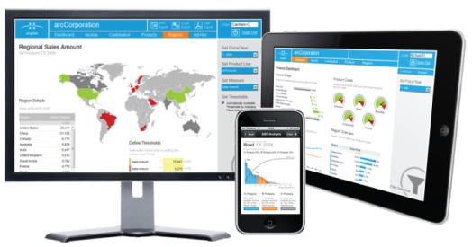
Business Case
Business intelligence dashboards

Slide 4
Business Case
Results
  Improvements and benefits
    User perspective
    Company perspective
potential increase the sales of the refrigerator.
transform from traditional household appliances
company to smart household appliances.

Slide 5
Business Case
Conclusion
Every house needs one smart refrigerator and the smart shop list app.

